Slide 1
“Still Here”

Slide 2
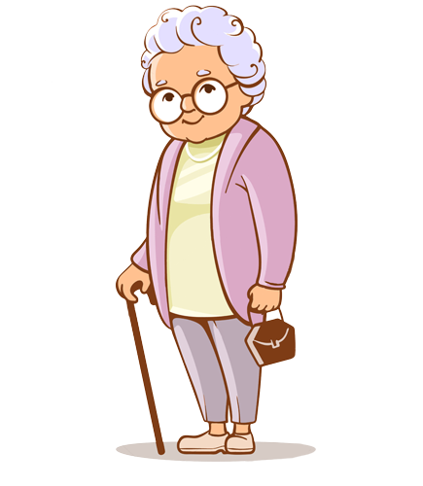
Grandmother
The character in my archive proposal is my grandmother who passed away when I was little.

Slide 3
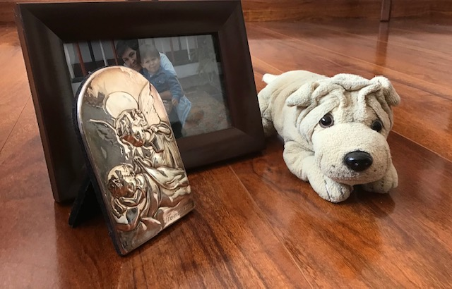
The objects
I´m going to work with 3 tangible elements which are directly related to my grandmother and the relationship we had.
At first and main, a stuffed dog which belonged to her and was given to me.
Secondly, I have photos and an angel of guard portray that she gave me.

Slide 4
Proposal platform
It’s sort of a digital sketchbook
The idea is to make a family album like book in which the presence of my grandmother is shown through the stuffed dog.
The album will be done in a digital platform, “Book Creator”

Slide 5
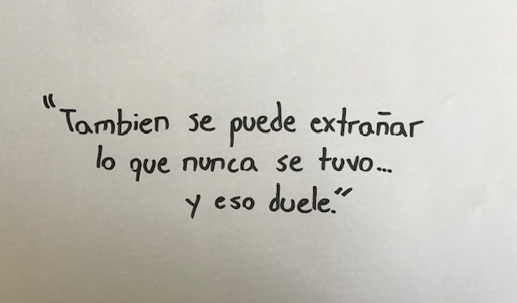
Concept to manage
The concept I intend to work on is what it could have been, the idea of reflecting on the impact of presence of a close person and struggling to figure out what they could have said or feel.
It is strongly linked to absence.

Slide 6
How?
The album will have to undelimited periods, one of contextualization and the other one of afterwards.
In the contextualization I will include photos of us along with sentences from the “I Remember” experimentation as well as other personal elements that evoke her figure on me.
For the afterwards I will include images of important moments of life in company of the presence of the stuffed animal who will say phrases I believe she would have said.

Slide 7
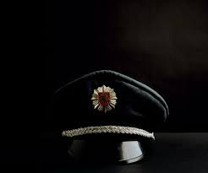
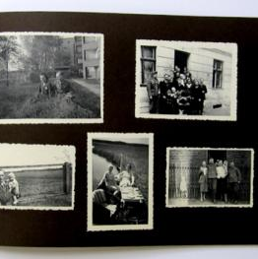
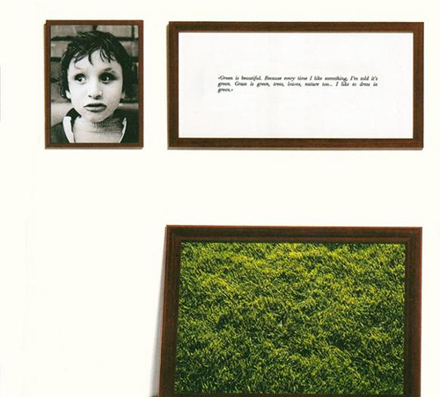
References
Indre Serpytyte
Chrsitian Boltanski (“Family albums”)
Sophie Calle (“Los Ciegos” texts)

